Slide 1
Journey
Map
Deepthi Peter
Associate Data Engineer

Slide 2
Azure ML Studio (03/10/2023)
Key Learnings:
What is Azure ML Studio?
Azure Machine Learning Studio is a collaborative, drag-and-drop tool you can use to build, test, and deploy predictive analytics solutions on data
Offers support for end-to-end machine learning lifecycle – from preparing data, building and training models, validation and deployment, and monitoring of models

Slide 3
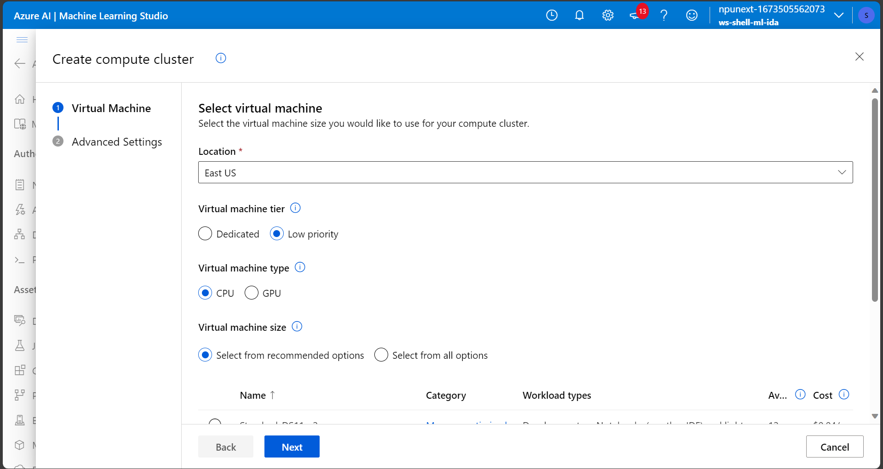
Create a compute Cluster on ML Studio

Slide 4
Azure ML Studio (04/10/2023)
Key Learnings:
Design ML pipelines
Automated ML

Slide 5
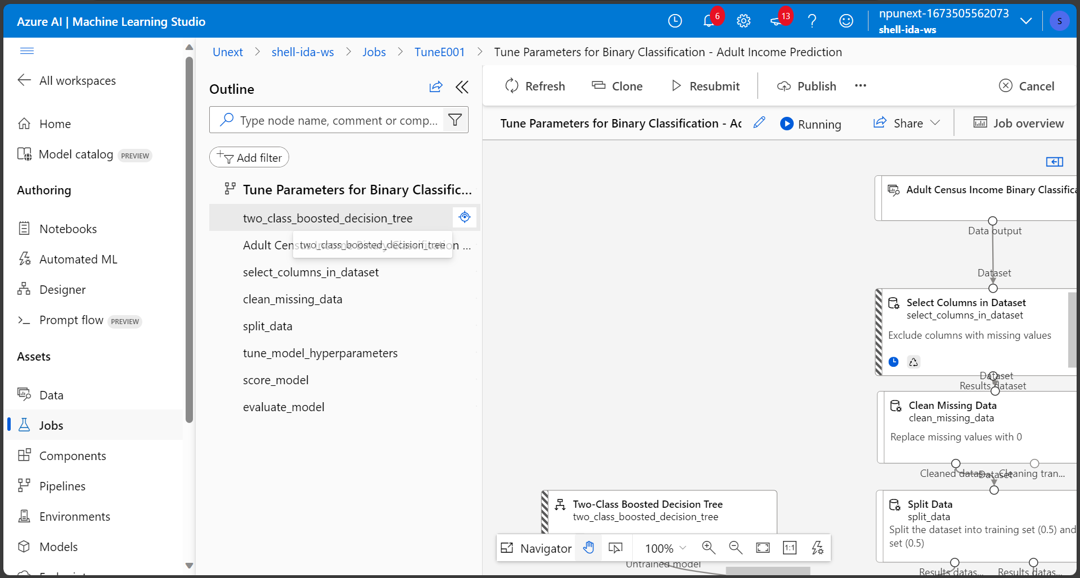
ML Pipeline

Slide 6
Thank You

